Slide 1

Multi-Class sound classification using machine learning
ANURAG ABHAY SINGH - x18104053
KANISHK CHAUHAN - x17106354
XIE SHUANGYIN - x18126634
VAIBHAV SINGH - x17165954

Slide 2
Introduction
Sound
Sound is form of energy which is captured by brain sensor at different frequency.
Audible frequency range is 20Hz ~ 20kHz.
Sound is necessity requirement for doing everyday work efficiently.
Why its important to classify sound?
For Hearing aid technology.
Context awareness from environmental sounds for security purpose by checking noise.
Audio tagging of videos which helps in understanding video.
For improving Self driving cars process by Artificial intelligence.
Goal of the project
To classify different sources of sound from overlapped audio data by machine learning so that in future automatic and fast sound classification can be done.
Deign a efficient methodology than previous work done in sound classification fields.
System designing which can help in classifying sounds source from overlapping noise.

Slide 3
Related work
The areas mostly covered in sound classifications
Heart Sound classification.
Animal sound classification.
Acoustic event classification.
Environmental sound classification.
Machine classification on basis of sounds
Research Question
To what extent proposed machine and deep learning algorithm can accurately classify different sources of sounds?
The most widely used feature for sound classifications
Linear predictive coefficients (LPC)
Mel-frequency cepstral coefficients (MFCCs)
The most widely used algorithms for sound classifications
K nearest Neighbour (k-NN)
Convolutional Neural Network (CNN)
Deep Neural Network (DNN)
Support Vector Machines (SVM)
Random Forest
Naïve Bayes

Slide 4
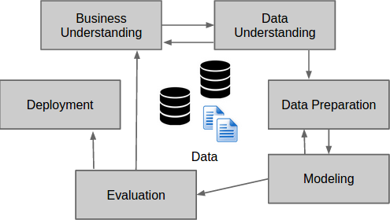
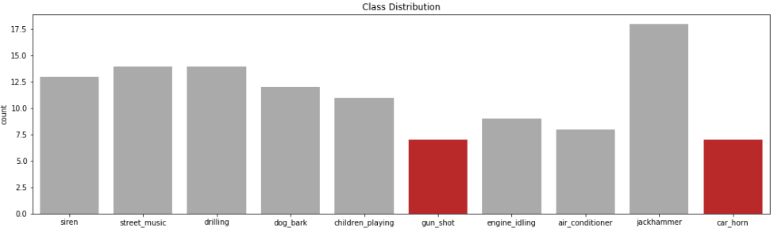
Proposed Methodology
CRISP-DM
Data understanding-The dataset used in the project is obtained from site www.urbansounddataset.com. The dataset contains 8732 rows of WAV format data in numeric form under 10 classes of AC, horn, children, dog barking, street music, gunshot, engine, siren, jack hammer and drilling sound which is recorded in environmental condition.
Business understanding-The main objective behind developing this project is to understand the complex sound classification which indirectly helps in setting business goals.
Data Preparation – 1.Feature engineering 2. Data cleaning 3.Feature Scaling

Slide 5
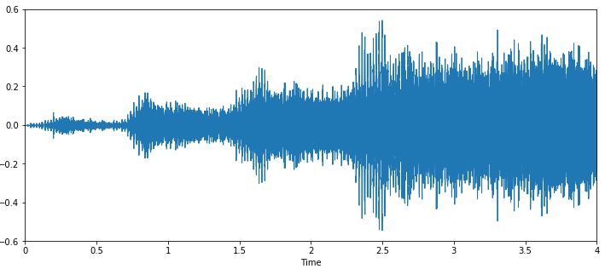
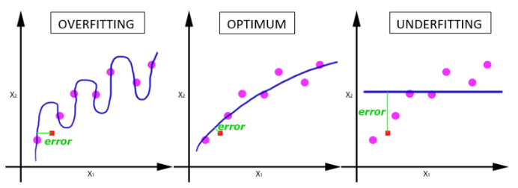
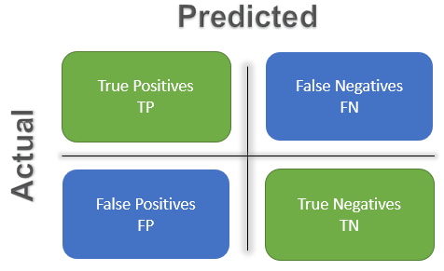
Data Modelling
Feature Selection (Librosa)
If linear relation is known between different features it can help in optimizing model by avoiding over fitting. MFCC features extracted from audio.
Training and test set
75/25
Classification Model
k-NN
RF
SVM (RBF kernel)
ANN
Evaluation Technique to validate model
Epoch vs. Accuracy Graph
Confusion matrix
Epoch vs. Accuracy
Precision = TP
(TP+FP)
Recall = TP
(TP+FN)
Accuracy = TP + TN
(TP+FP+TN+FN)
F1 Score = 2*Precision*Recall
(Precision + Recall)

Slide 6
Reason for using selected models
k-NN
K-NN does not require training, especially suitable for multi-classification problems.
k-NN takes handles distorted noise dataset robustly in fast computational time.
RF Classifier
It is robust classification method because it avoids randomness in data plus errors size are reduced due to usage of significant features for predicting yes or no area for variable.
RF compared to k-NN handles outliers and noise easily and has no effect in predicting new instances.
The best part of RF is to calculate proximity of data of test set so that unwanted data can be replaced or removed.
SVM
The algorithm performance remains same even if the all variables in category are changed because whole responsibility of classification is supported by that two supporting vectors which indirectly supports decision boundaries.
Because of such dependency on extreme vectors to classify category of variables SVM is one of the risky algorithm, contradicting to it the related work section shows it one of the mostly used and the one to achieve reasonable high classification.
ANN
ANNs have the ability to learn and model non-linear and complex relationships.
After learning from the initial inputs and their relationships, it can infer unseen relationships on unseen data as well, thus making the model generalize and predict on unseen data.
ANNs can better model heteroskedasticity i.e. data with high volatility and non-constant variance, given its ability to learn hidden relationships in the data without imposing any fixed relationships in the data.

Slide 7
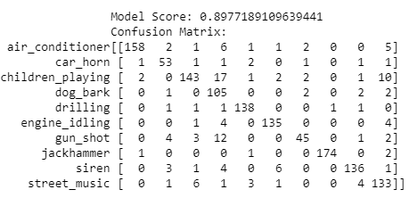
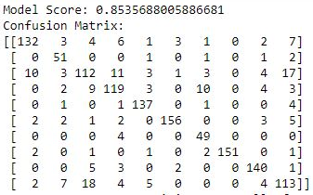
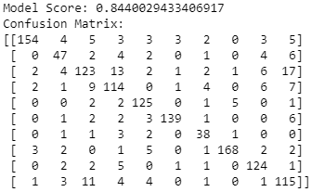
Results
Models | Accuracy | Precision | Recall | F1 score
SVM | 85.35 | 0.84 | 0.86 | 0.85
k-NN | 89.77 | 0.89 | 0.88 | 0.88
RF | 84.40 | 0.83 | 0.84 | 0.84
k-NN
Vs.
SVM
Vs.
RF

Slide 8
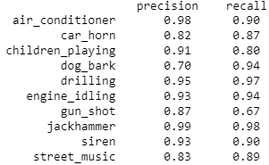
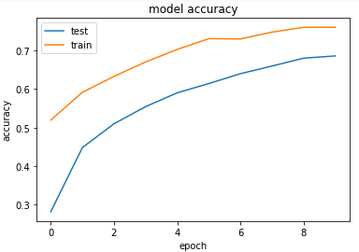
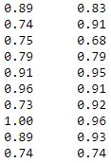
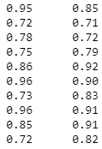
Results
k-NN
Vs.
SVM
Vs.
RF
ANN
Random forest classifier predicted 95% sound with precision of AC, engine idling, jack hammer class. 72% Sounds of Street music and car horn class were the least predicted by RF as just because of noisy data in that environment.
k-NN showed 98% precision accuracy and for jack hammer it has least precision of 99%. k-NN has least accuracy in classifying dog bark sound class , but on environmental sounds noisy data had seemed to rarely affect the accuracy has it classified children sound and street music by 91% and 83% accurately.
SVM has achieved a reasonably high and similar accuracy as like RF but no match at any par to k-NN in classifying environmental sounds as it also show sensitivity to noise in class data by 74%. Except gun shot sound class which was classified by SVM only 73% accurately even when the recall was 92%. SVM classified jackhammer sound with 100% precision.
ANN accuracy in classifying multi class label showed 89.93% accuracy only fractional higher than the k-NN.
The graph epoch vs. accuracy above clearly show the optimum curve of test and training model.
Visualising the graph clears the understanding that as the weighted average of data is keep on increasing the accuracy of model is optimized by ANN .

